Slide 1

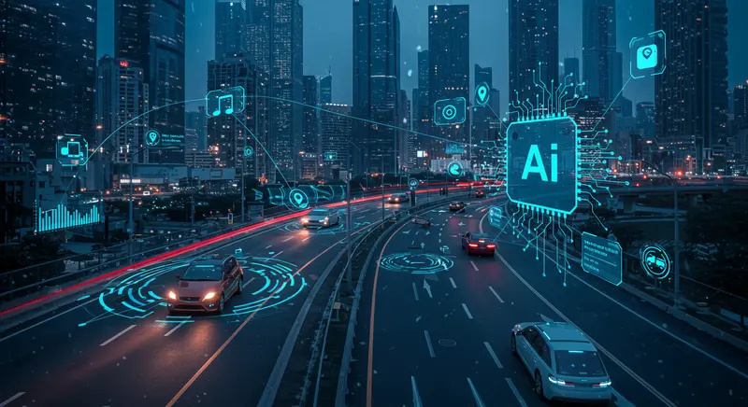
Decoding Tourist Voices:
A Data-Driven Analysis
NLP-Powered Text Analytics & Web Scraping Project
Presented By: Satyaprakash Behera
(24MBMB14)
School of Management studies

Slide 2
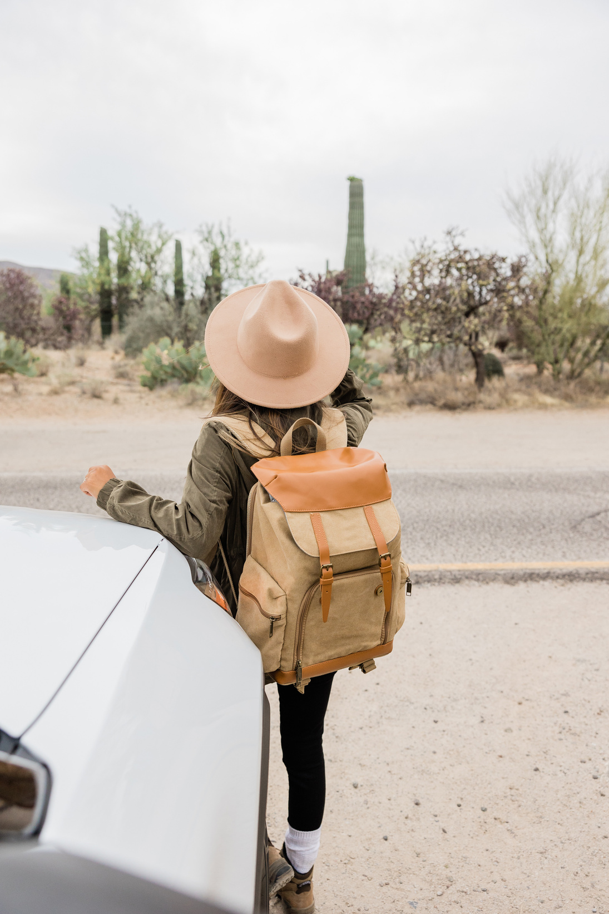


Problem Statement
Objective:
Tourism reviews across India hold valuable insights into traveler experiences, yet they remain unstructured and unutilized.
Problem:
Large volumes of scattered tourist reviews on the web
Lack of systematic analysis to identify sentiment, issues, and trends
Need for automated NLP-based systems to support travel decision-making
Goal:
To build a data-driven platform that analyzes and visualizes traveler experiences for improved travel safety and satisfaction.

Slide 3

Methodology
Step 1: Data Collection (Web Scraping)
Collected 400+ real-world tourist reviews from multiple destinations across India
Automated using Python and BeautifulSoup
Step 2: Data Preprocessing
Cleaned, tokenized, and normalized text
Removed stopwords and redundant characters
Step 3: NLP Techniques Applied
Sentiment Analysis (VADER)
Keyword Extraction (YAKE)
Emotion Detection (Text2Emotion)
Topic Modeling (NMF & TF-IDF)
Issue Identification (Rule-based NLP + Summarization)

Slide 4


Implementation
Tools & Libraries:
Pandas
Workflow Overview:
NLTK
Scrape → Clean → Analyze → Visualize
Scikit-learn
Built modular scripts for each NLP use case
Gensim
Combined all insights into an interactive Streamlit Dashboard
Plotly
Dashboard Features:
Streamlit
Destination-wise sentiment charts
Keyword trends & emotion insights
Topic distribution visualization
Map view of sentiment across India

Slide 5
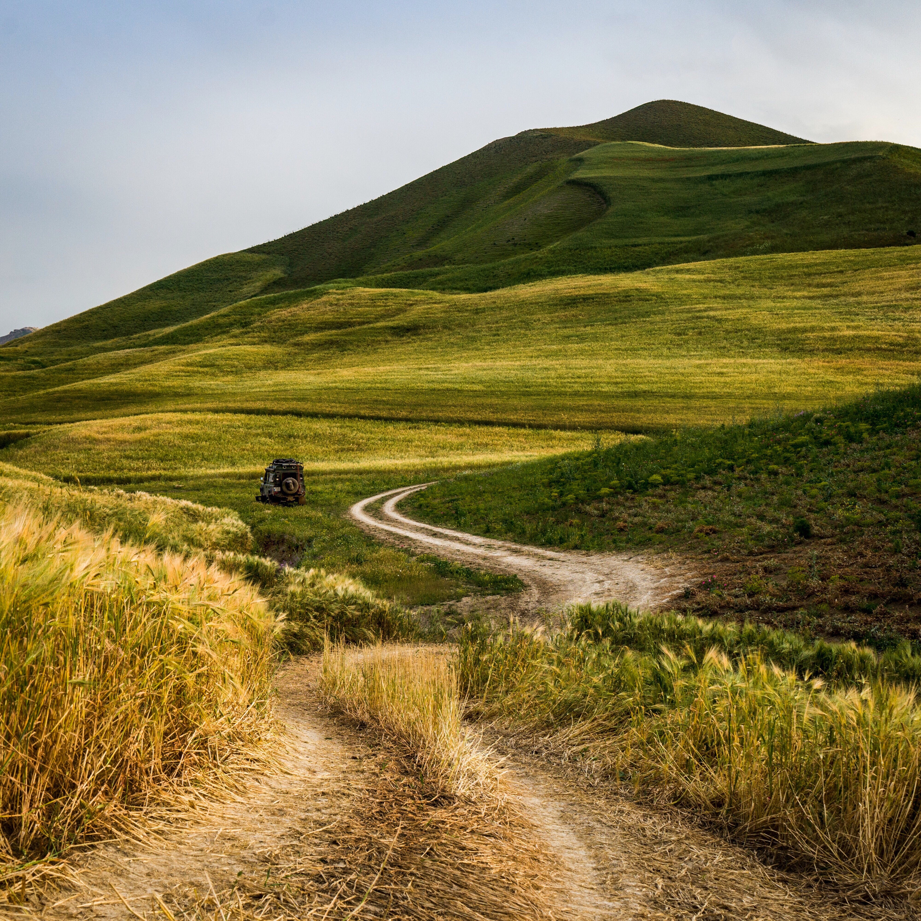
Results &
Insights
Sentiment distribution: ~75% positive, 15% neutral, 10% negative
Common issues: safety, crowd, cleanliness
Top emotions: joy & surprise
Frequent keywords: “travel”, “people”, “experience”, “safe”, “beautiful”
Emerging topics: Solo Travel, Seasonal Trips, Logistics
Outcome:
✅ Created an end-to-end NLP-based analytics dashboard
✅ Demonstrated how big data can enhance tourism insights
✅ Paved the way for smarter, safer travel experiences in India

Slide 6
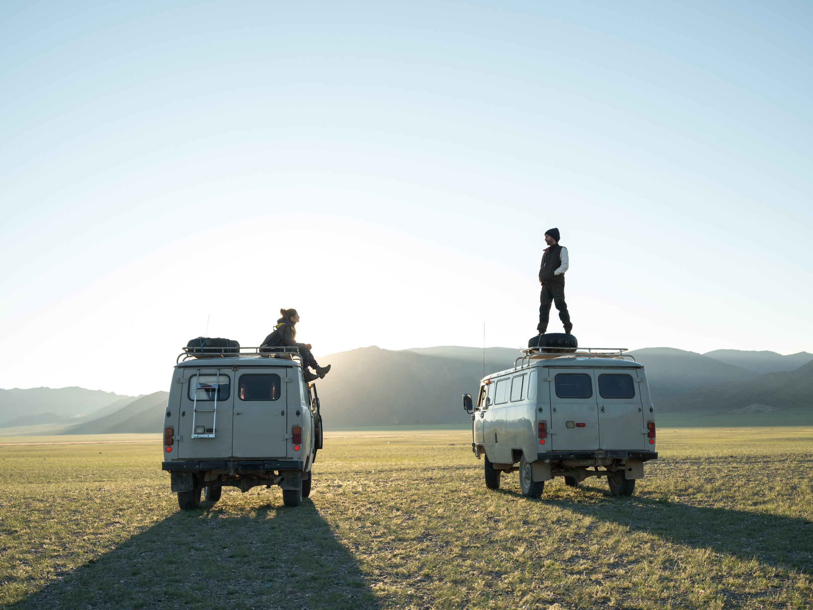
Thank
You

